Slide 1

SOLELY FOR PURPOSES OF FORAGE WORK EXPERIENCE
Predicting Customer Buying Behaviour

Slide 2
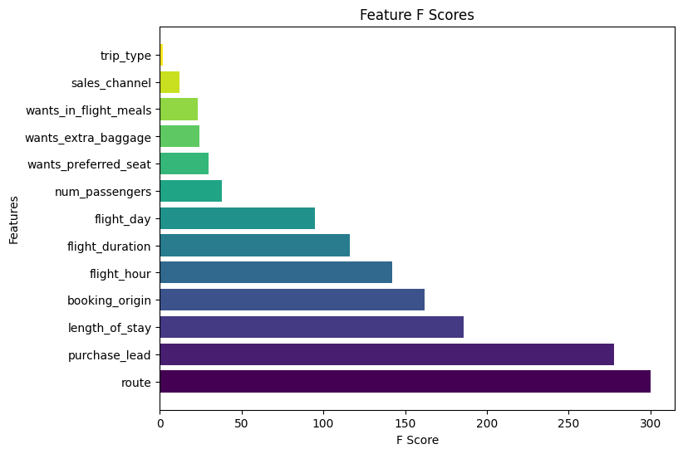
SOLELY FOR PURPOSES OF FORAGE WORK EXPERIENCE
Predictive Model To Understand Booking Behaviour
I Used SVGBoost Model to build a model with predictive accuracy of 85%
The most Important features that influence customer buying behaviors are:
Route
purchase_lead
lenght_of_stay
booking_origin
flight_hour

